Slide 1
April is the cruellest month
Why?

Slide 2
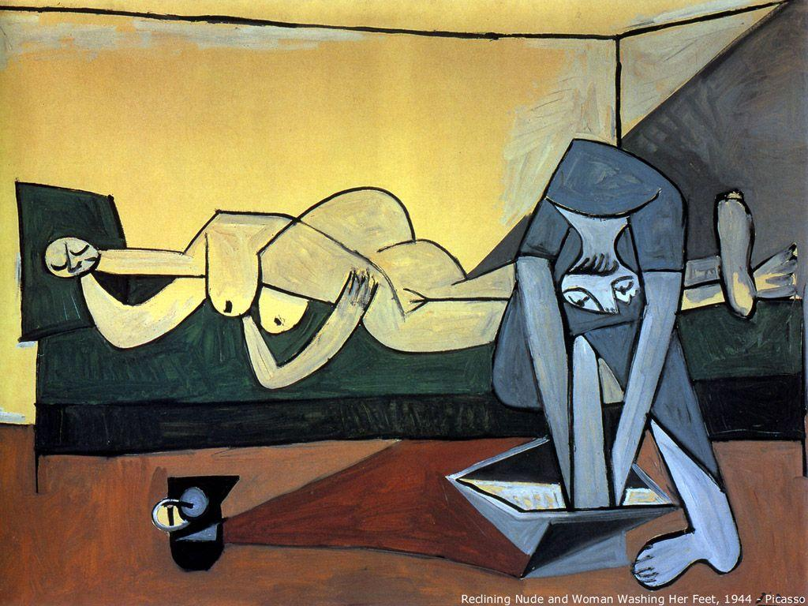
What is the meaning of this Picasso painting?

Slide 3
Non-figurative art is not supposed to mean anything.
Paintings can have abstract meaning and may represent an emotion or be about a color, texture, shape, or process.
What does it represent?

