Slide 1
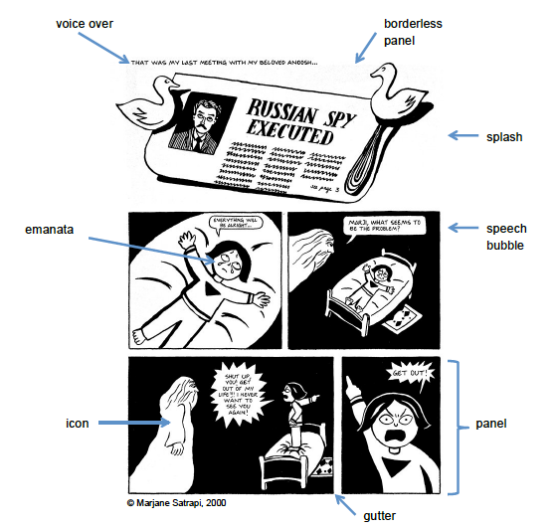
Panel: The framed image. Purpose: offers the reader a perspective or point of view aka
camera angle
Gutter: Space between the panels
Purpose: Readers “fill in the blanks” and image what
happens between panels.
Panel
Gutter

Slide 2
Voice Over
Borderless Panel
Splash
Splash: a panel that spans the width of the page.

Slide 3
Voice Over
Borderless Panel
Speech Bubble: Frames around the characters’ language
How can you tell the difference between:
A characters direct speech
A character’s thoughts
A character shouting
Speech bubble

Slide 4
Voice Over
Borderless Panel
Emanata: teardrops, sweat drops, question marks, or motion lines to portray emotions
Emanata
Icon

Slide 6
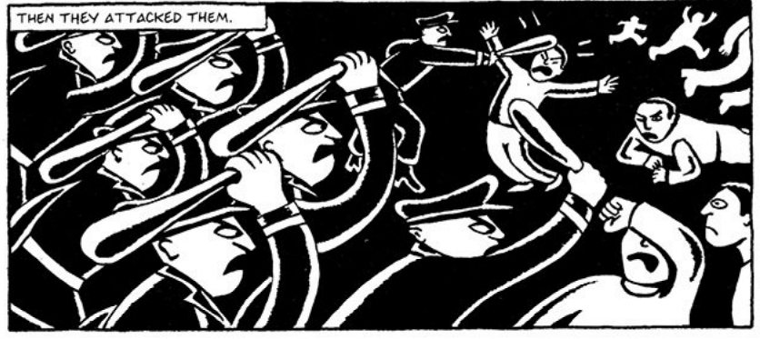
Graphic Weight: The amount of contrast in an image. i.e. black and white, shades of grey in between.
What is the effect of the graphic weight in this image?
Foreground: Subject of point of focus for the reader, usually closest to the reader.
Midground: Subject standing in the middle. An off-centre subject can be used to create visual tension
Background: Objects in the background help add contextual information for the reader.

